Slide 1

Customer Shopping Behavior Analysis
Uncovering strategic insights from 3,900 transactional purchases.

Slide 2

CHAPTER 1: PROJECT SCOPE
Project Overview & Goals
Data Scope
Key Objectives
Analyzed 3,900 purchases across various product categories.
Uncover spending patterns, customer segments, and product preferences.
Strategic Goal
Guide business decisions using insights on subscription and purchase behavior.

Slide 3

CHAPTER 1: DATA
Dataset Summary
3,900
Key Features Tracked
Customer Demographics (Age, Gender, Location)
Total Rows
Purchase Details (Category, Amount, Size, Color)
Transactional purchase records.
Behavior (Discount, Previous Purchases, Subscription Status)
18
Columns
Features including demographics and purchase details.
37
Missing Values
Found in the Review Rating column.

Slide 4

CHAPTER 2: DATA PREPARATION
Exploratory Data Analysis (Python)
01
Data Cleaning & Imputation
Handled missing Review Ratings using median imputation by product category.
02
Standardization & Engineering
Renamed columns to snake case. Created age_group and purchase_frequency_days.
03
Consistency Check
Verified and dropped redundant promo_code_used column.
04
Database Integration
Loaded cleaned DataFrame into PostgreSQL for structured SQL analysis.

Slide 5
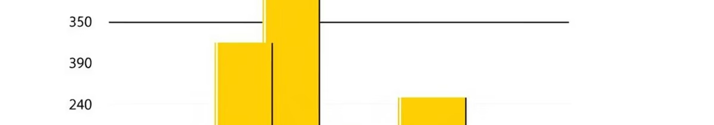
CHAPTER 3: KEY FINDINGS (SQL)
Revenue & Spending Patterns
Revenue by Gender
Male customers generated significantly more revenue ($157,890) than Female customers ($75,191).
Shipping Type Comparison
Express shipping users had a higher average purchase amount ($60.48) than Standard shipping users ($58.46).

Slide 6


Subscription & Loyalty Insights
Subscription Spend
Repeat Buyer Loyalty
Non-subscribers had a slightly higher average spend ($59.87) than subscribers ($59.49).
Customers with >5 purchases are more likely to subscribe (958 Yes vs. 2518 No).
Customer Segmentation
Majority of customers are "Loyal" (3,116), followed by "Returning" (701) and "New" (83).

Slide 7
CHAPTER 3: KEY FINDINGS (SQL)
Product Performance & Discounts
Top 5 Products by Rating
Discount-Dependent Products
Gloves (3.86)
Products with the highest percentage of discounted purchases:
Sandals (3.84)
Boots (3.82)
50%
Hat (3.80)
Hat
Skirt (3.78)
49.66%
Sneakers
49.07%
Coat

Slide 8
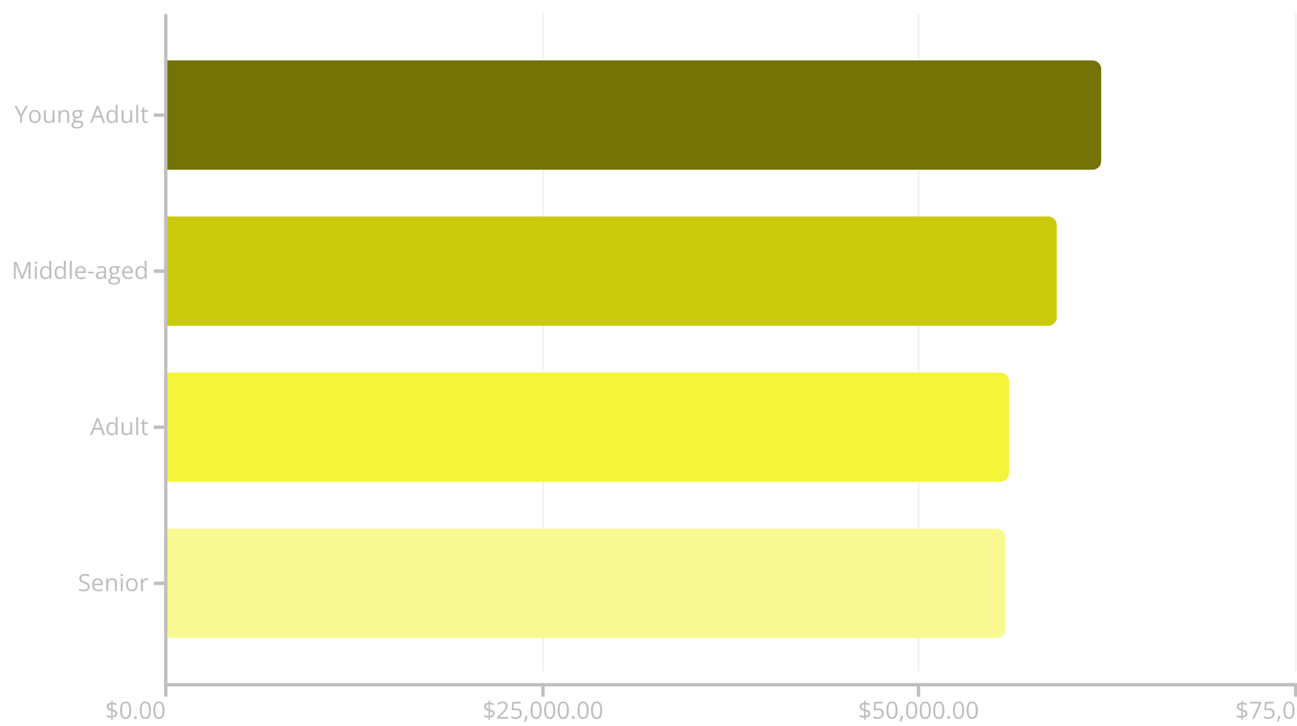
Revenue Contribution by Age Group
Young Adults are the highest revenue contributors, followed closely by Middle-aged customers.

Slide 9
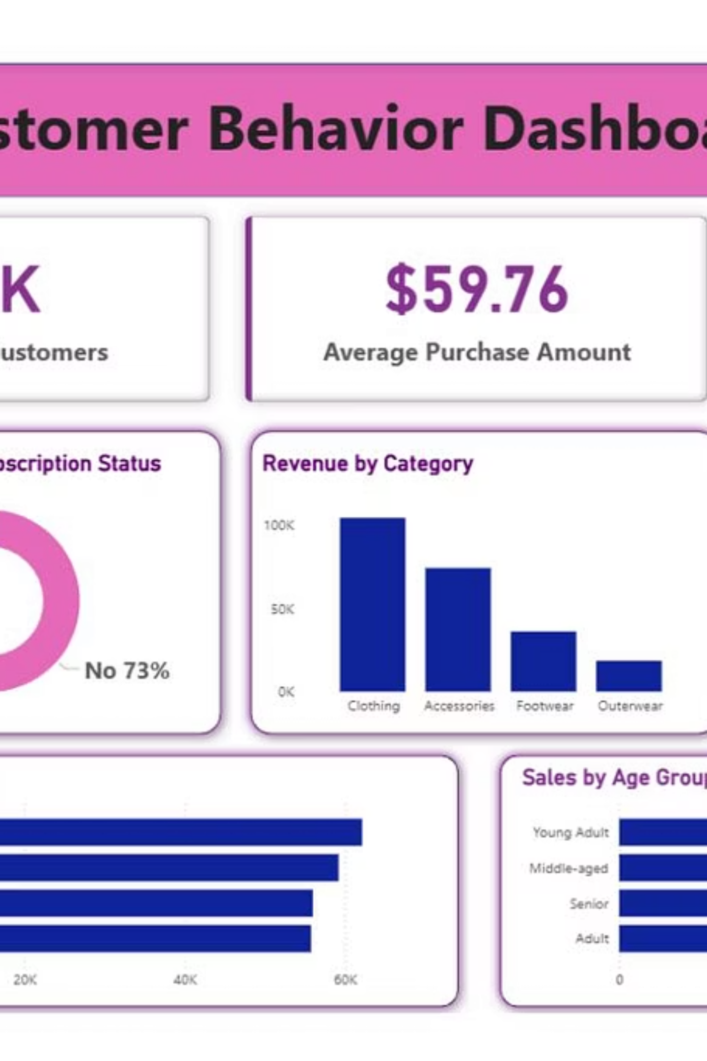

CHAPTER 4: VISUALIZATION
Power BI Dashboard
Interactive visualization was created to present these insights to stakeholders.
The dashboard provides real-time filtering and drill-down capabilities for deeper exploration of the data.

Slide 10

CHAPTER 5: STRATEGY
Business Recommendations
1
Boost Subscriptions
Promote exclusive benefits to increase subscriber base, especially among repeat buyers.
2
Review Discount Policy
Balance sales boosts with margin control, especially for high-discount items like Hats and Sneakers.
3
Targeted Marketing
Focus campaigns on high-revenue age groups (Young Adult) and Express-shipping users.
4
Product Positioning
Highlight top-rated products (Gloves, Sandals) in marketing campaigns.

